Slide 1

Acoustic Scene Classification using Deep Learning Architecture
Category – Acoustic Scene Classification
Name – Sumit Gaurav
Roll No. – 2402102012
M.Tech. - CSP

Slide 2

Abstract
Introduction
Research Paper implementation
Implementation using ANN
Summary
Conclusion

Slide 3

Introduction
The main aim of the project is to classify audio recordings based on the scene analysis and observing the environment wherein they are recorded.
The models proposed in the research paper are two deep learning algorithms CNN and CRNN which are used to perform classification of acoustic scenes using ReLU as activation function. The highest accuracy achieved for ASC task is 90%.
I have also initially performed the ASC task using a trivial ANN model wherein I am expecting an accuracy of around 60%. For this case I have per

Slide 4

Research Paper Implementation
→

Slide 5

Related Work
Spectral Features for ASC
Deep learning approach for ASC
Spectral features like spectral centroid, zero-crossing rate, MFCCs, and linear predictive coefficients are important for acoustic scene classification (ASC).
These features, initially made for speech tasks, help in identifying different sound environments. MFCCs are commonly used, and pairing them with Gaussian Mixture Models (GMM) has worked well in past ASC challenges like DCASE.
The rise of deep learning has influenced ASC research. CNN, particularly Residual Networks (ResNet), have been used for classifying acoustic scenes.
Techniques such as log-mel spectrograms, deltas, and delta-deltas are used to train CNNs, and combining different frequency paths has been shown to improve performance.
Machine Learning Approach for ASC
Fusion & Hybrid Deep learning models
Traditional machine learning approaches, such as combining MFCC features with GMM and using Support Vector Machine (SVM) classifiers, have shown promising results in ASC.
For example, MFCC features encoded from Recurrence Quantification Analysis (RQA) parameters were used with SVM to outperform other methods in the DCASE 2013 challenge.
Recent work involves fusing multiple deep learning architectures to improve ASC accuracy. For example, combining VGG-like 2D CNNs, Light CNNs with Max-feature Map activation, and 1D CNNs (x-vector topology) achieved a high accuracy of 77%.
However, training such complex models can be computationally expensive.

Slide 6




Proposed Methods (in RP)
Datasets
Feature Extraction
Dataset used is DCASE 2019 Acoustic Scene Classification Task 1a development dataset.
10 acoustic scene Airport, Bus, metro, metro station, public square, park, mall, street traffic etc.
Number of audio recording present are 14400 and it is a balanced dataset. Each consisting 1440 data points.
Feature extracted from audio recordings is log-mel spectrogram.
In the dataset the duration of acoustic signal is short so to achieve more distinct info. a conventional STFT is performed on audio before extracting log – mel spectrogram feature.
Number of Mel-bands set is 40. The feature considered are from DCASE 2019 baseline model.
Activation Function
ReLU
Leaky ReLU
ELU

Slide 7
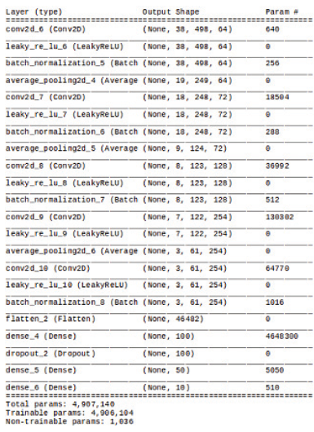
CNN Architecture
Model summary for CNN
01
Convolution & Pooling Operations
The network starts with convolution blocks that have varied filters and kernels, followed by max-pooling layers to down-sample the features. Batch normalization is applied to prevent bias in the values.
03
Dropout Layer
04
Output Layer with Activation
The final dense layer contains neurons equal to the number of classes in the dataset, and the softmax activation function is used to output the probability distribution over the classes.
02
Flattening and Dense layer
A flatten layer is used to convert the multiple convolutional blocks into a single dimension, followed by two dense layers to further process the features.
A dropout layer is introduced to reduce the risk of overfitting and improve generalization.

Slide 8
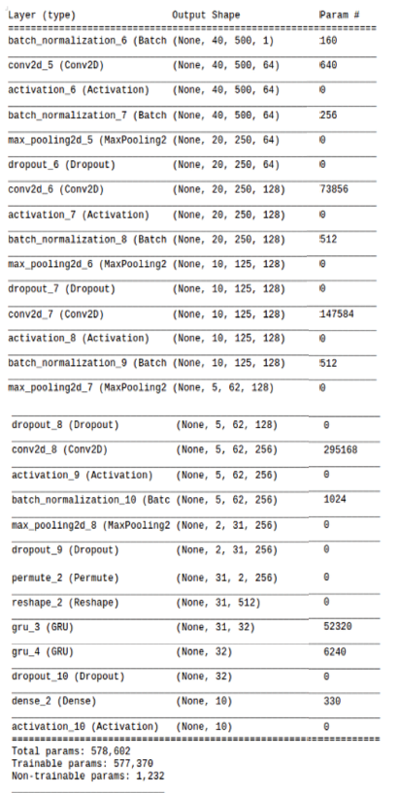
CRNN Architecture
Model summary for CRNN
01
Convolutional and Max-Pooling Blocks in CRNN
The CRNN architecture starts with convolution and max-pooling blocks, followed by activation layers, batch normalization, and dropout layers. These initial layers help in feature extraction and regularization to avoid overfitting.
03
Gated Recurrent Units (GRUs)
04
Output and Regularization
The output from the bidirectional GRU layers is fed into fully connected dense layers. A dropout layer is introduced in the network to prevent overfitting, ensuring the model generalizes well to unseen data.
02
Feature Transformation from CNN to CRNN
A key difference between CNN and CRNN models lies in the feature dimensions. In CNN, the feature vector is three-dimensional, while in CRNN, it is two-dimensional.
The CRNN architecture incorporates two Gated Recurrent Unit (GRU) layers, which capture temporal information by considering past timestamps. These GRU layers help model sequential data in acoustic scene classification tasks.

Slide 9
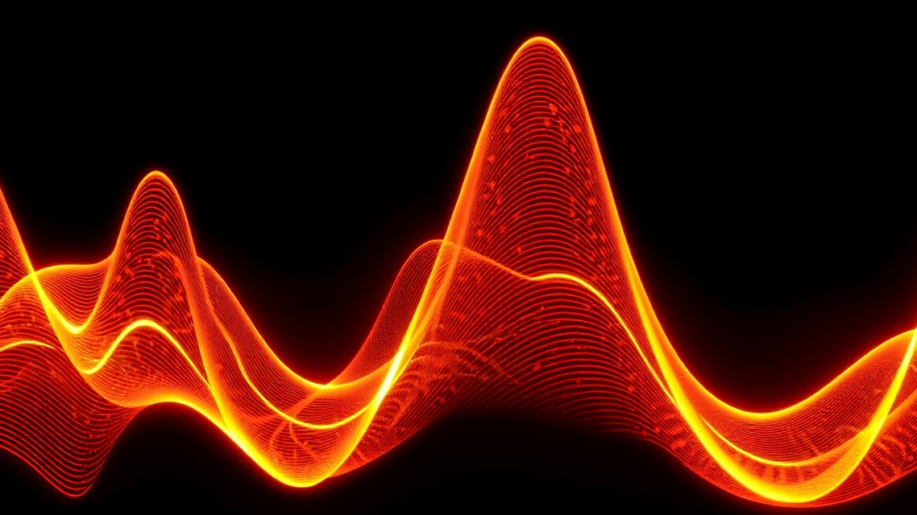
Implementation using ANN
→

Slide 10

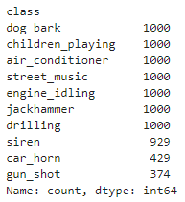
Data Preprocessing
Datasets
This dataset (UrbanSound8K) contains 8732 labelled sound excerpts (<=4s) of urban sounds of 10 acoustic scenes.
Air conditioner, car horn, children playing, dog bark, drilling, engine idling, gun shot, jackhammer, siren, and street music
Number of audio recording present are 8732 and it is a balanced dataset.
The dataset has been divided into two categories for training & testing.
For training I have considered 6985 data points and for testing 1747 data points.
Breakdown of dataset
Activation Function
For hidden layer ReLU has been used as activation function.
For the final layer softmax has been used as activation function
ReLU

Slide 11

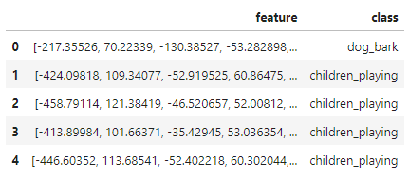
Feature Extraction
Feature Extraction
Here we will be using Mel-Frequency Cepstral Coefficients (MFCC) from the audio samples.
The MFCC summarises the frequency distribution across the window size, so it is possible to analyse both the frequency and time characteristics of the sound.
These audio representations will allow us to identify features for classification.
Librosa library has been used to convert audio data to a mono signal (only one feature). Audio data will be normalized between -1 to +1.
The audio signal can be represented as the independent (extracted features from audio signal) and dependent (class label names) features.
Sample of extracted features
Instead of Librosa library we can also use Scipy library which will give two features for each audio data. So, due to this there will be two independent variables.
This increses the number of iteration it takes more time to process the data points and increases the complexity of the model.

Slide 12
Summary
ASC with Deep Learning
CNN and CRNN are two primary models used for acoustic scene classification.
CNN: Suitable for spatial feature extraction but struggles with temporal dependencies.
CRNN: Combines CNN’s spatial processing with RNN’s temporal understanding, making it superior for sequential tasks like ASC.
ASC with ANN
Completed the data preprocessing and feature extraction are tabulated.
Have also developed the training model but it has some error which needs to be rectified.
Expected accuracy using this model is around 60 % which is low but considering this is a computationally cheap model.
Key Performance Metrics
CRNN + ELU: Achieves the best performance with an accuracy of 90.96%, surpassing CNN and the baseline models.

Slide 13

Conclusion
CRNN outperforms CNN in acoustic scene classification due to its ability to handle temporal dependencies in sound.
The choice of activation function, dataset, and architecture plays a crucial role in model performance.
Sumit Gaurav
2402102012

Slide 14
References:-
Research Papers -
Acoustic Scene Classification using Deep learning models (CNN and CRNN)
LINK - https://ieeexplore.ieee.org/stamp/stamp.jsp?tp=&arnumber=9418177
Acoustic Scene Classification in DCASE 2019 challenge: Closed and Open set classification and Data mismatch setups.
LINK - https://github.com/coreprinciple6/Acoustic-Scene-Classification/blob/master/Documentation/Papers%20Reviewed/DCASE2019Workshop_Mesaros_14.pdf
Datasets -
UrbanSound8K
LINK - https://www.google.com/url?q=https://goo.gl/8hY5ER&sa=D&source=editors&ust=1724337228690386&usg=AOvVaw1eb1JSj-71IThF6zO4zDWT

